Slide 1
Data Presentation Improving Employee Retention Through Feedback Insights Tool; Python (Pandas, Seaborn, Matplotlib) Brume Pascal | Data Analyst | June 2025

Slide 2
Business Context & Problem
2
Bright Wave Solutions faced rising employee disengagement.
The causes of dissatisfaction were unclear and varied across teams.
Traditional surveys were collected but underutilized as feedback remained unstructured and unanalysed.
HR lacked visibility into key issues impacting retention, morale, and productivity.
Without data-driven insight, the risk of talent loss and declining culture was growing.

Slide 3
Project Objectives
3
Analyze employee feedback data to understand sentiment and satisfaction patterns
Identify key drivers of satisfaction and dissatisfaction
Explore differences in feedback across tenure levels and office locations
Deliver clear, actionable insights to help HR improve retention and engagement.

Slide 4
Our Approach
Explored over 1,000+ survey entries from employees
Analyzed structured ratings (e.g., satisfaction, management, compensation)
Studied engagement patterns by tenure and location
Identified recurring themes in open comments (positives, negatives, advice)
Visualized trends using Python (Pandas, Seaborn, Matplotlib)
Clean
Explore
Compare
Recommend
Collect
Analytical
Approach

Slide 5
What We Found — Quick Overview
5
🟢Strengths: Employees appreciate the company’s culture and career opportunities.
🔴Weaknesses: Compensation and remote work satisfaction are consistently rated low.
🔄Mixed Signals: Career growth improves with time, but new employees don’t feel it yet.
🧘Wellness Programs: Satisfaction is much higher among engaged employees; this is a clear opportunity.
📅Sentiment Over Time: Ratings are stable but not improving and showing no immediate crisis, but room for proactive change.

Slide 6
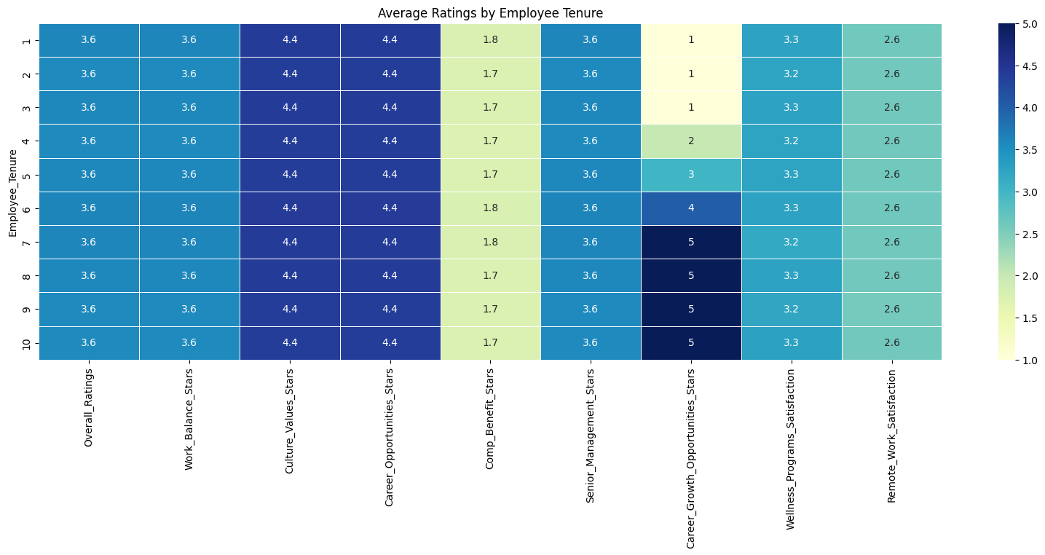
What Do Employees Think Based on Their Tenure?
📈 Career Growth Improves Over Time
New employees rate growth very low (1.0/5), but this steadily increases over time as they gain more working experience, reaching 5.0 by Year 7+.
❌ Compensation Remains a Concern
Ratings remain consistently low at ~1.75/5; no improvement on payments with time spent at the company.
😐 Overall Satisfaction Is Steady
Employees consistently rate their overall satisfaction around 3.6/5, regardless of tenure.

Slide 7
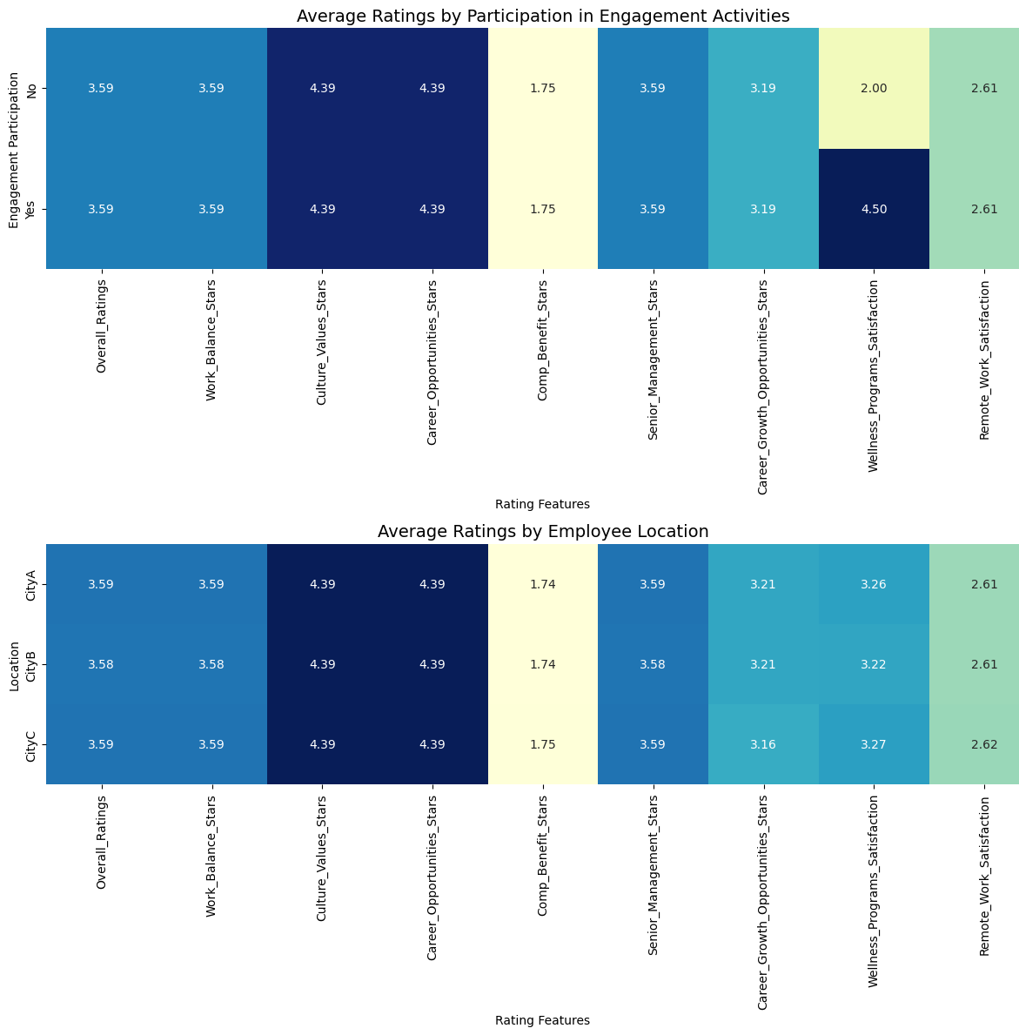
Does Location or Engagement Affect Employee Experience?
📅 Engagement Participation Is Even Across Locations Employees from City A, City B, and City C participate in engagement activities at similar rates.
➤ This means engagement programs are distributed and not biased by location.
📋 Engagement Doesn’t Strongly Affect Most Ratings For most satisfaction metrics, employees rate things similarly whether they participate in engagement activities or not, But there's one clear exception:
Wellness Program Satisfaction
Participants rate it around 4.5
Non-participants rate it around 2.0
➤ This shows that people who feel supported through wellness initiatives are more likely to engage with the company.

Slide 8
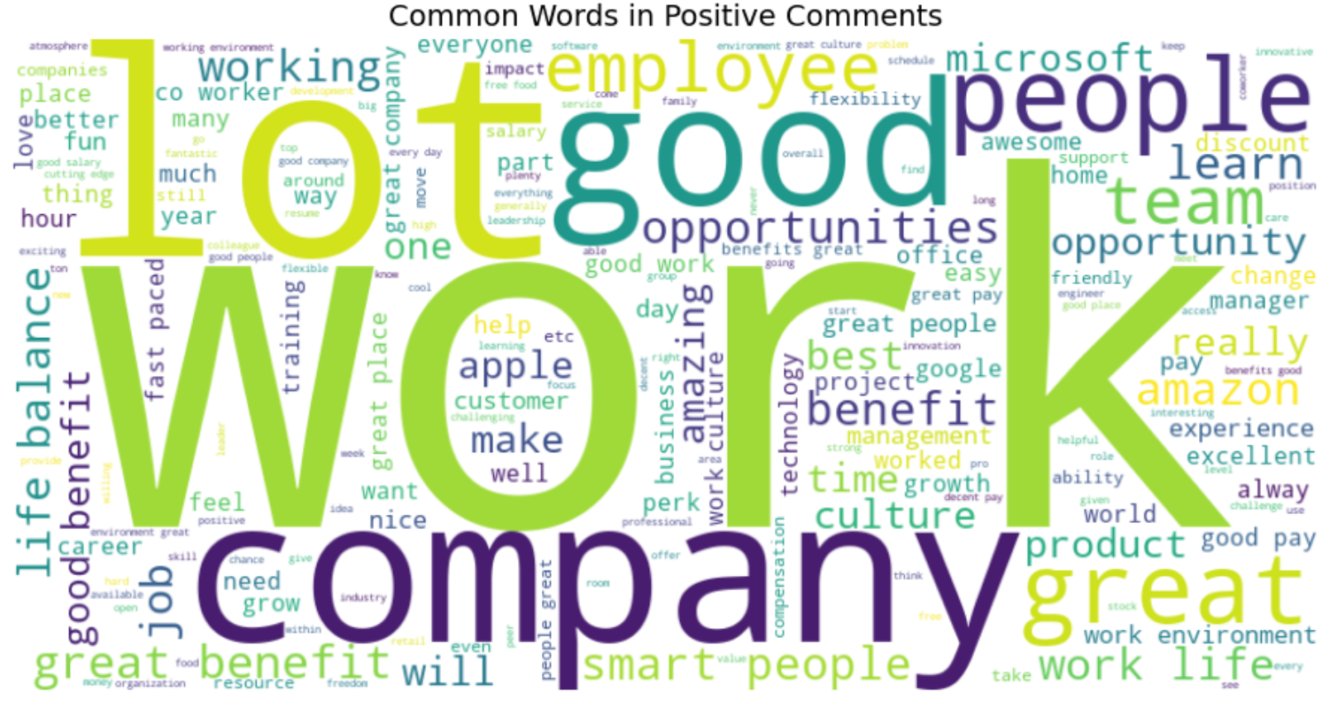
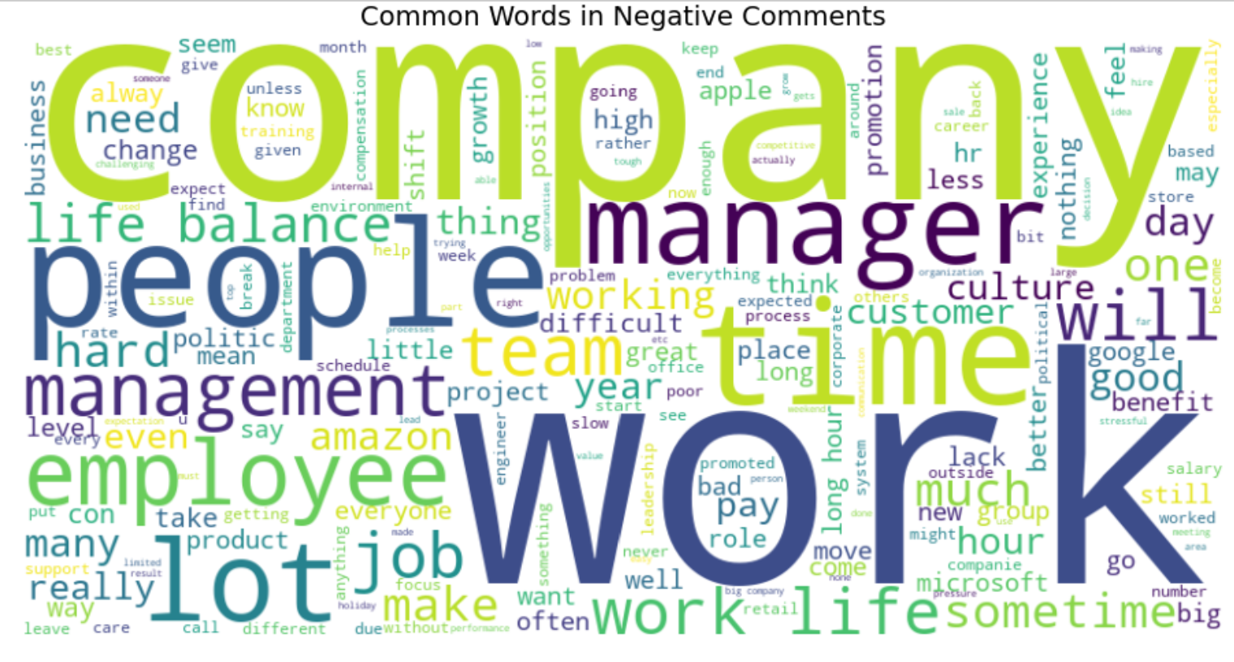
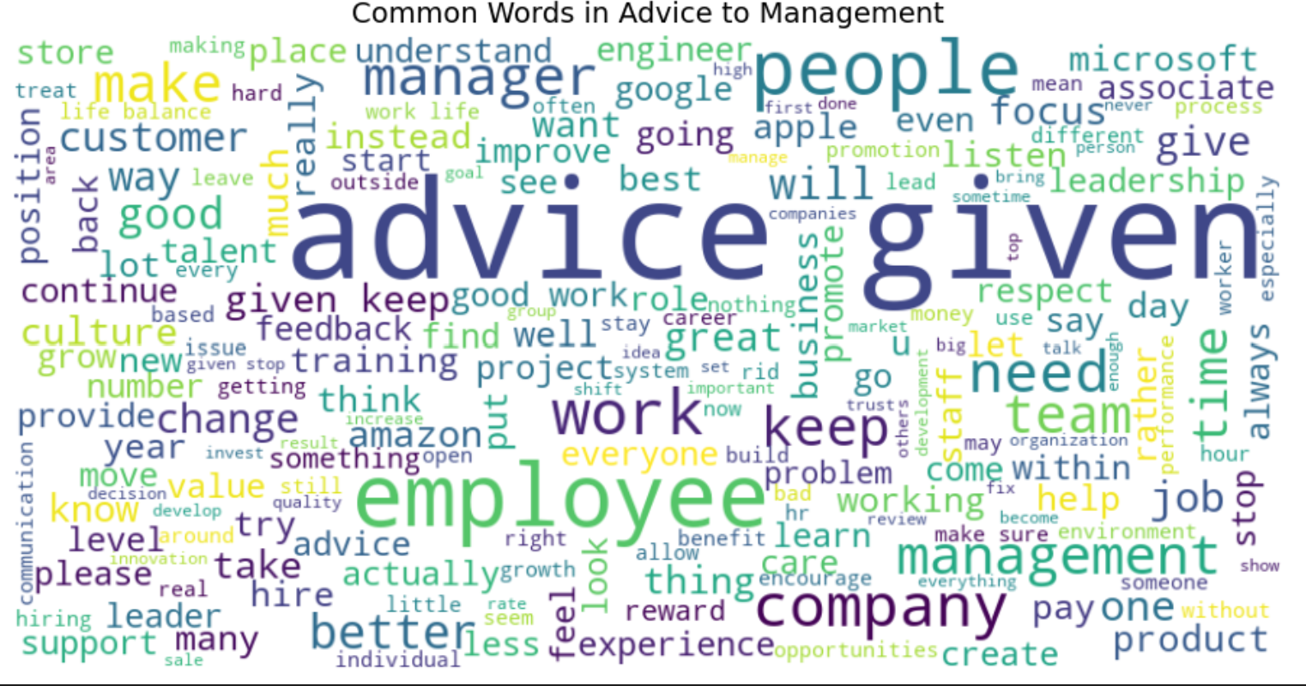
What Themes Stand Out in Employee Comments?
👍 Positive Comments - Common words: “company,” “work,” “great,” “team”
➤ Employees appreciate the overall environment and their teams. There's a sense of pride in the culture.
⚠️ Negative Comments - Frequent terms: “manager,” “time,” “workload”
➤ These point to concerns around leadership quality, time management, and possibly burnout or overwork.
💬 Advice to Management - Recurring words: “give,” “support,” “people,” “listen”
➤ Employees want better communication, more recognition, and leadership that listens actively.

Slide 9
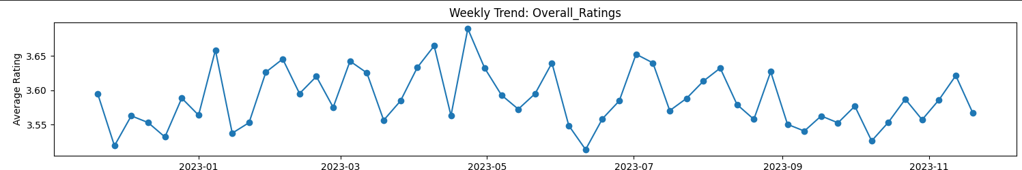
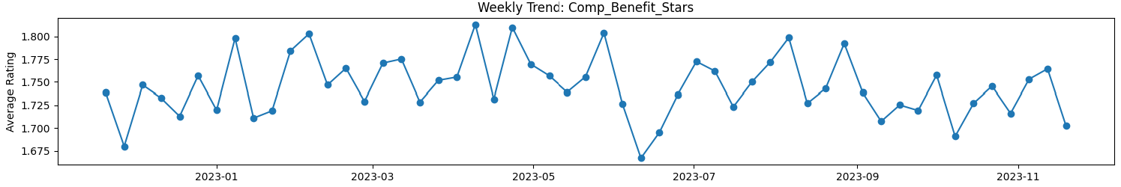
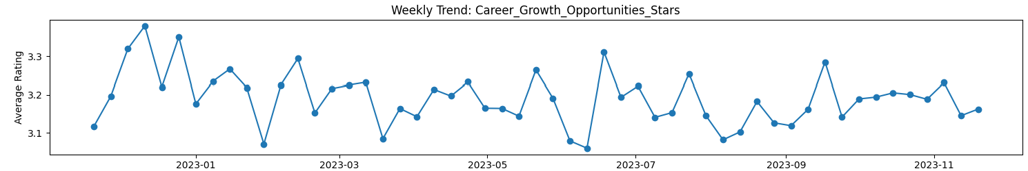
Are Employee Sentiments Changing Over Time?
✅ Ratings Are Stable Over the Year: There are no significant changes in key metrics like Overall Satisfaction, Culture, or Senior Management. Sentiment remains consistent neither improving nor worsening.
❌ Compensation Remains a Persistent Issue: Weekly averages for Compensation stay low, around 1.7–1.8, throughout the period. This shows a missed opportunity to address one of the most pressing concerns.
📈 Career Growth Shows Some Fluctuation: Ratings for Career Growth vary slightly week-to-week, but without a clear upward trend. Suggests inconsistent experience across teams or timeframes.

Slide 10
What Are the Most Important Insights?
✅ Strengths
Company Culture is highly rated; employees feel aligned with values
Career Opportunities score well, especially for long-term staff
Overall Satisfaction is moderate but stable at 3.59/5
⚠️ Challenges
Compensation & Benefits are consistently low (~1.75/5)
Remote Work Satisfaction is weak (~2.61/5); policy gaps likely
Career Growth starts low as new hires see little advancement early on
🔍 Opportunities
Career Growth rises with tenure; Management should structure mentorship or pathing early
Wellness Program Satisfaction is a strong driver of engagement
No significant bias by location, very consistent experience across offices

Slide 11
Recommendations : What Should HR Do Next?
💰 Revamp Compensation Strategy
Conduct a full review of pay structures.
Improve transparency around salaries and highlight non-monetary benefits (e.g., recognition, flexibility, training access).
🧸 Refresh Wellness & Remote Work Policies
Boost employee awareness and participation in wellness initiatives.
Reevaluate remote work options like consider more flexibility or hybrid models.
🎯 Strengthen Career Development Paths
Define clear growth trajectories.
Introduce mentorship programs, learning budgets, and internal mobility opportunities.
📊 Adopt Continuous Feedback Systems
Implement ongoing sentiment tracking (e.g., monthly pulse surveys).
Create dashboards to help HR monitor trends and act in real time.

Slide 12
Conclusion: Data with Purpose
Thanks to this data-driven approach, Bright Wave Solutions now:
✅ Understands what matters most to employees; Culture, compensation, career growth, and wellness, clearly prioritized through data
✅ Can take focused, actionable steps to Address pain points with confidence and clarity
✅ Has built a foundation for sustainable HR strategy to Empower long-term engagement, satisfaction, and retention
📆 Looking Ahead
Establish a continuous feedback loop
(e.g., quarterly pulse surveys)
Integrate sentiment insights into strategic HR decisions and planning

Slide 13



Thank You
Opitien Brume Pascal
linkedin.com/in/pascalbrume
https://pascalbrume.netlify.app/

